Slide 1
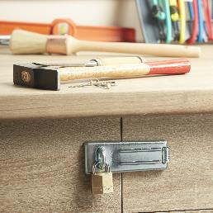
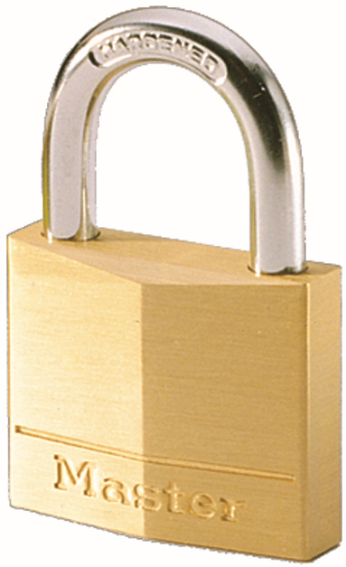
130EURT – 30mm solid brass keyed padlocks, pack of 2
Ideal for securing locker rooms, cupboards, tool boxes…
30mm wide solid brass body
  Better resistance to shocks
Hardened steel shackle - 16mm high, 5mm diameter
  Better resistance to bolt cutter attacks
Dual locking
  Better pulling resistance
4-pin cylinder
  Better pick resistance
Padlock opens
  The same key opens both padlocks
Limited lifetime warranty
Reference | 130EURT
Code EAN13 | 3520190193223
Packaging | 4 / 24
Price excl. tax | €

