Slide 1
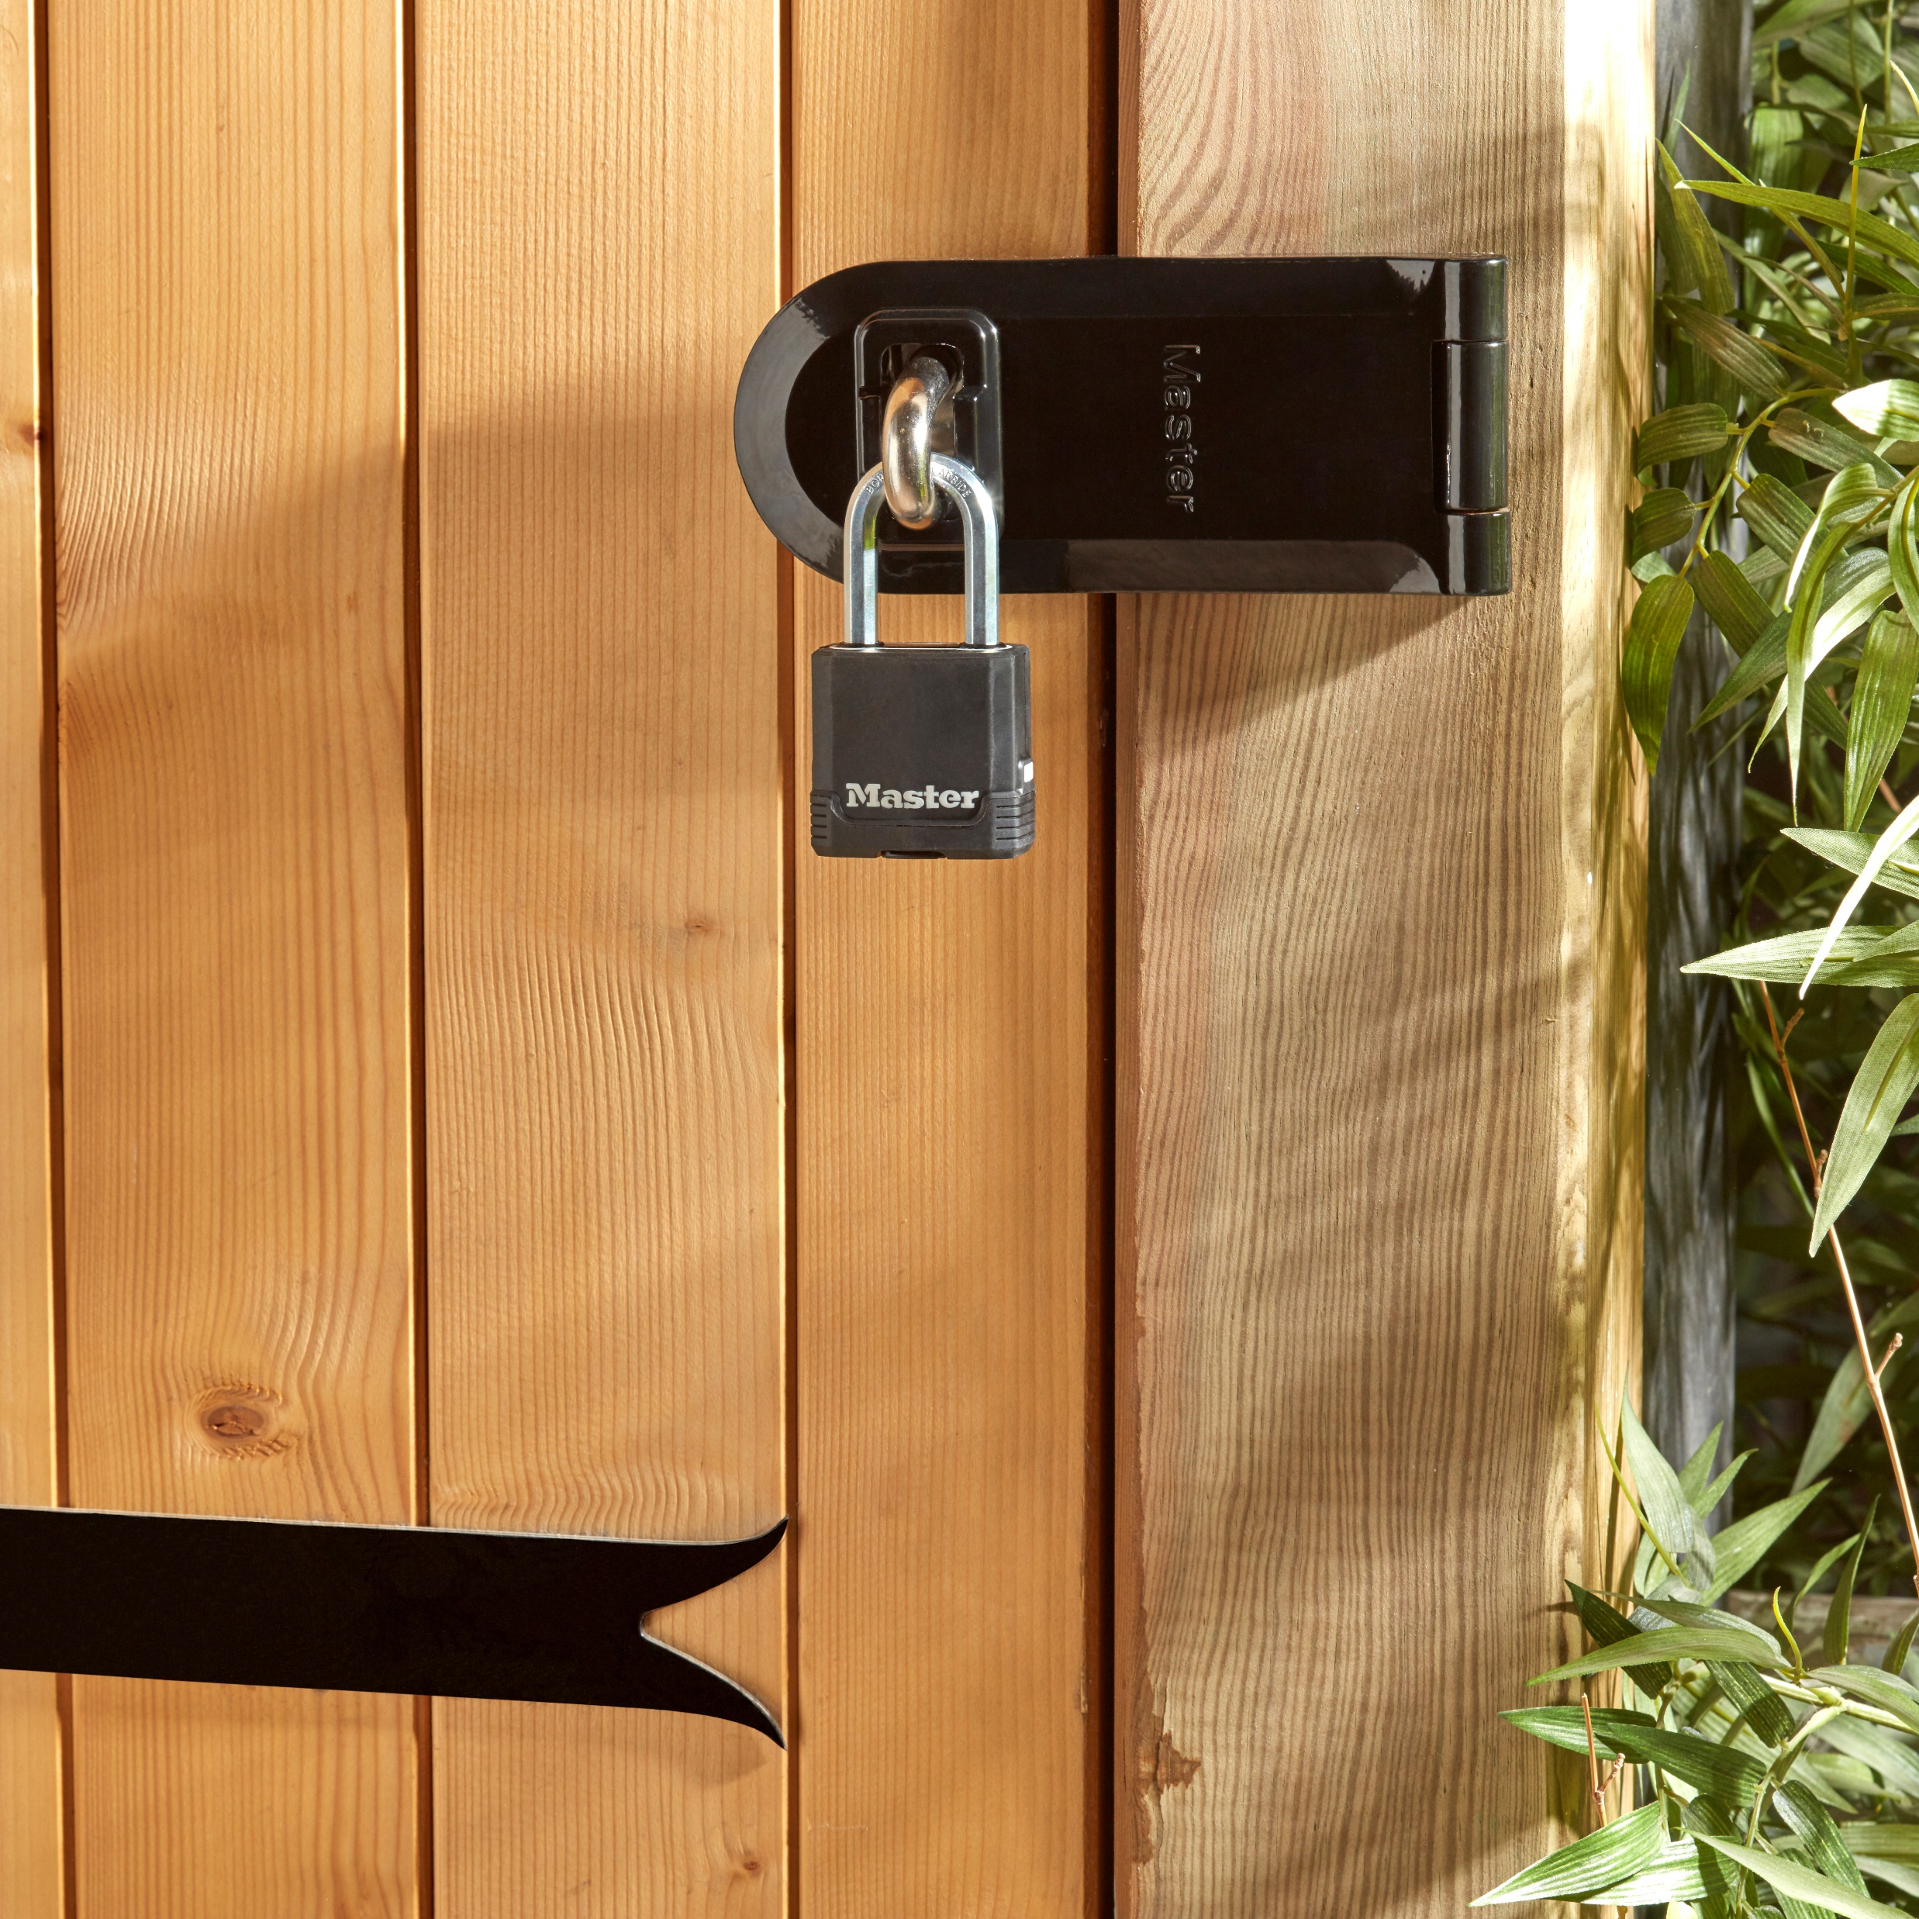
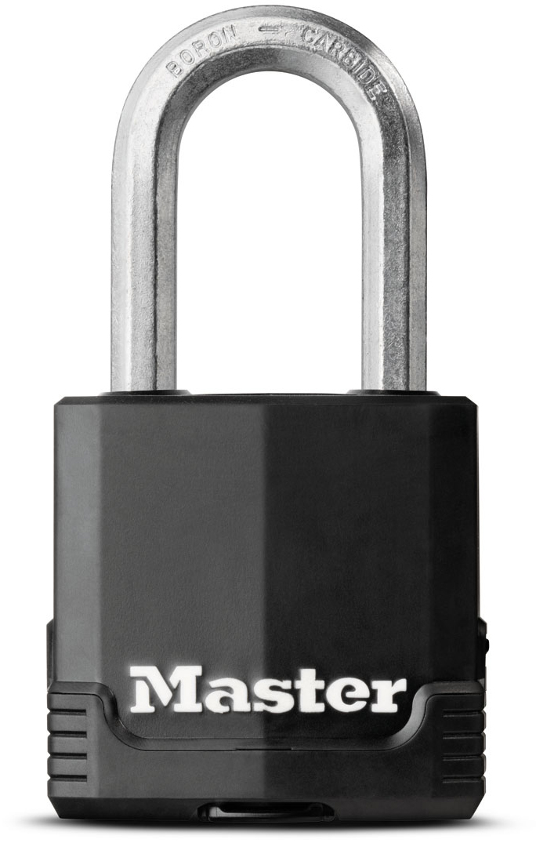
M115EURDLF – 48mm Excell keyed padlock, thermoplastic cover
Ideal for securing gates, boats, metal shutters…
48mm wide laminated steel body
  High security and high resistance to shocks and hammering
Vinyl protection on the body and cylinder
  Excellent rust resistance
Octagonal patented boron-carbide shackle, 38mm high and 8mm diameter
  Maximum resistance to bolt cutter attacks
Dual ball bearing locking
  Maximum resistance to pulling and prying
4-pin cylinder
  Better pick resistance
Limited lifetime warranty
Reference | M115EURDLF
EAN code | 3-520190-93039-2
Packaging | 4 / 24
Price excl. tax | €

