Slide 1
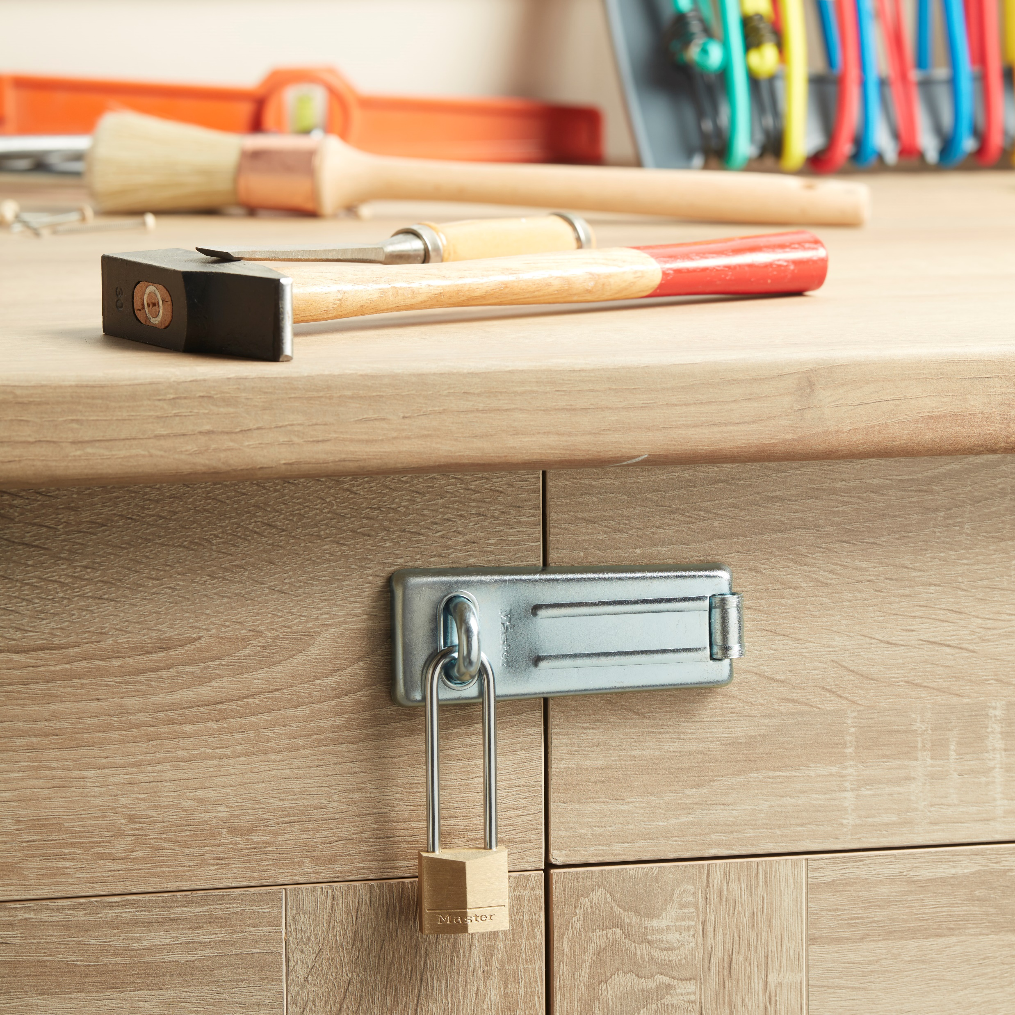
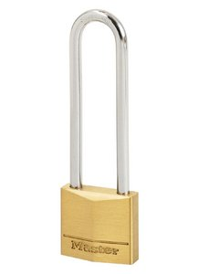
130EURDLJ – 30mm solid brass keyed padlock
Ideal for securing locker rooms, cupboards, tool boxes…
30mm wide solid brass body
  Better resistance to shocks
Hardened steel shackle - 64mm high, 5mm diameter
  Better resistance to bolt cutter attacks
Dual locking
  Better pulling resistance
4-pin cylinder
  Better pick resistance
Limited lifetime warranty
Reference | 130EURDLJ
Code EAN13 | 3-520190-091529
Packaging | 4 / 24
Price excl. tax | €

