Slide 1
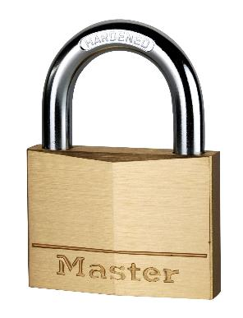
160EURD – 60mm solid brass keyed padlock
Ideal for securing sheds, gates, storage units…
60mm wide solid brass body
Better resistance to shocks and corrosion
Hardened steel shackle - 30mm high, 9mm diameter
Better resistance to bolt cutter attacks
Dual locking
Better pulling resistance
5-pin cylinder
Maximum pick resistance
Limited lifetime warranty
Reference | 160EURD
EAN code | 3520190093035
Packaging | 6 / 36
Price excl. tax | €

